Slide 1
Math 642: Introduction to Machine Learning Spring 2020 Supplemental: Time Series
Some of the figures in this presentation are taken from "An Introduction to Statistical Learning, with applications in R" (Springer, 2013) with permission from the authors: G. James, D. Witten, T. Hastie and R. Tibshirani

Slide 2
Time Series
Some of the most interesting phenomena we try to model are most appropriately represented with time as a primary feature
The Weather
The Stock Market
A Heartbeat
Social Sentiment
Sports Acheivements
How can we model and analyze time series data?

Slide 3
Trends, Cycles, Irregularities
Trends: a steady increase or decrease in the series.
Examples: Population of a country
Mortality Rates in an Epidemic
Cycles: a repeating pattern in the series
Examples: Seasonal Rainfall
Heartbeat
Irregularities: Random variation in the series
Examples: Stock Market
Over-Under Sports Betting
Sometimes a signal can be composed of all 3 components

Slide 4
Law of Parsimony
Strive for the time series model with the fewest components that models the data well.
Occam’s razor: “Simpler solutions are more likely to be correct than more complex ones”
Use cross validation to spot overfitting

Slide 5
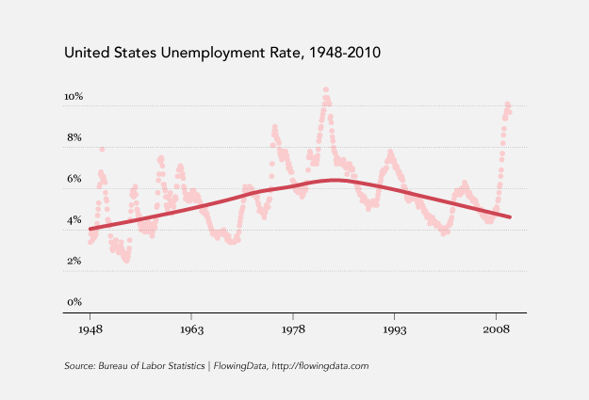
Moving Average
Time series data can be very noisy, and plotting time series data point by point can sometimes mask trends.
Often looking at a running average can smooth out the noise and make trends apparent. How is this similar to or different from K Nearest Neighbor?

Slide 6
ARMA
Another method of analyzing time series is using Auto Regression Moving Average. If the Unemployment Rate of a country depends on the previous 3 years, one can write
Unemployment Rate(year N) =
β₀+ β₁*UR(N-1) + β₂*UR(N-2) + β₃*UR(N-3) + ε
The mathematics for solving for the coefficients as a function of the error function is very similar to what we did in regression.
Reference: An Introductory Study on Time Series Modeling and Forecasting
by Ratnadip Adhikari and R. K. Agrawal

Slide 7
Time Series with Artificial Neural Network
weights
1
1
weights
Y_{n-1}⁽¹⁾
a₁⁽²⁾
y_{n}⁽³⁾
Features
Outcomes
(estimates or
Classes)
Y_{n-2}⁽¹⁾
a₂⁽²⁾
⁞
⁞
Y_{n-q}⁽¹⁾
a_{q}⁽²⁾
Layer 1
Hidden Layer(s) 2 to n)
Output Layer n+1

Slide 8
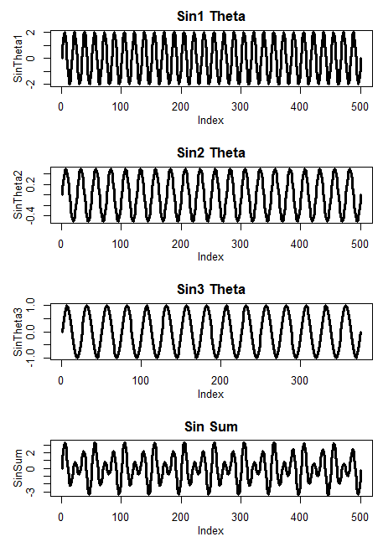
Fourier Basis Vectors
Spectral Models use sine waves as basis vectors. Any signal can be represented as a series of sine waves of different frequencies, each with a different weight.
Sine waves are orthogonal. In this case, orthogonal means that if you multiply one sine wave with another, over the full extent of the wave, you will get cancellation.
Fourier
Analysis
Any
Signal
Weights for
Sine Waves

Slide 9


Fourier Transform
definition:
,
:
The Fourier Transform simply takes a function of a spatial or temporal variable (x) and expresses it as a function of frequency (ξ )
You can take the Fourier Transform by hand, but some lazy people use the R function fft. It works quite well and returns the complex transform for a sine wave input.

Slide 10
How does the Fourier Transform Work?
Say f(x) is a sin wave with a frequency ξ₁. The integrand takes sin(ξ₁) and multiplies it by e^{i2πxξ}
Remember that e^{i2πxξ} = cos(2πxξ) + i*sin(2πxξ)
For any value of ξ not equal to ξ₁, the 2 sine waves will destructively interfere and you will end up with a value of zero. When the value of ξ matches ξ₁, the waves will constructively add.

Slide 11
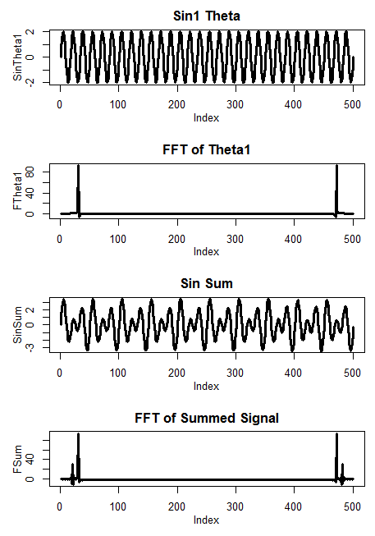
Fourier Transform of a Single Tone
The frequency of this wave is 30 cycles per unit length (go ahead, count them)
Peak corresponds to wave frequency
Doesn’t know if the frequency is positive or negative (2 peaks)
Height corresponds to wave amplitude
Phase corresponds to starting point of wave

Slide 12
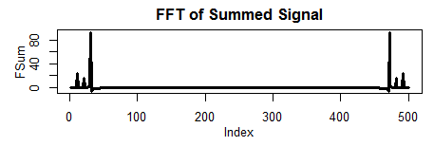
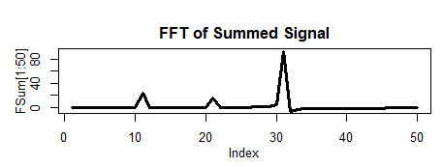
Fourier Transform of a Complex Wave With 3 Tones
This is the composite wave from slide 4 made up of 3 sine waves
Peaks corresponds to wave frequencies
Heights corresponds to wave amplitudes
Phase corresponds to starting point of wave

Slide 13
Measures Characterizing a Signal
Dominant Mode (Dominant Frequency)
Spectral Density Estimation
Compare Areas Under the FFT Curve: Ratio of high/medium/low frequency area to total area under the curve
Pulse-to-Pulse Variability (Matched Filtering)
All of the above can involve isolation of signal from noise before applying various analytic techniques

Slide 14
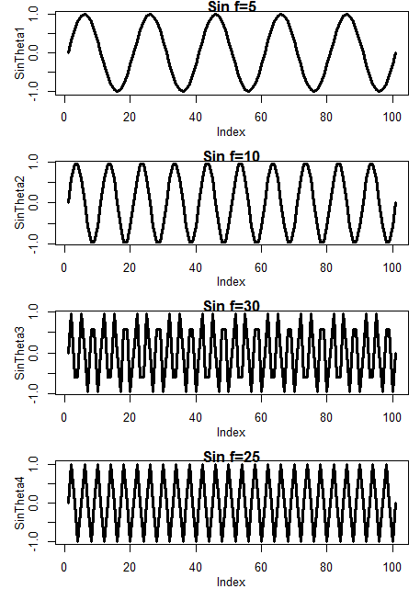
Matched Filters
A Matched Filter allows one to search through a complex waveform for a known pattern

Slide 15
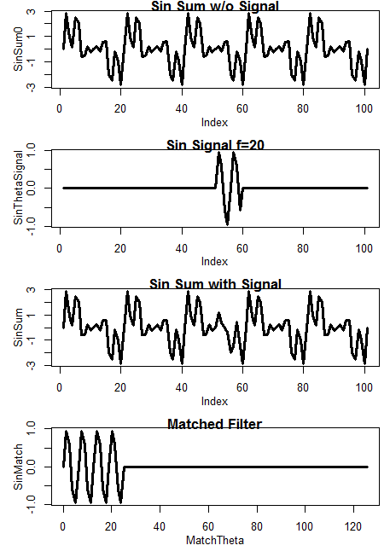
Matched Filters
Here is the composite
waveform without the
signal
Here is the signal
Here is the composite
waveform with the
signal

Slide 16
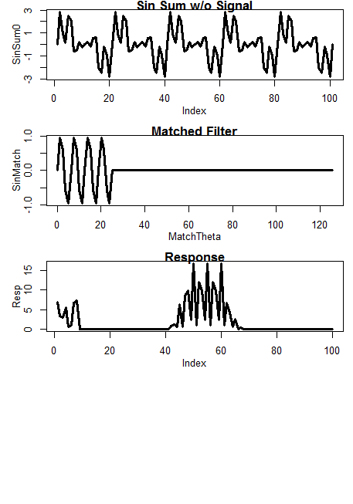
Matched Filters
Here is the signal
Here is the composite
waveform with the
signal
Here is the matched
filter
Here is the Response

Slide 17
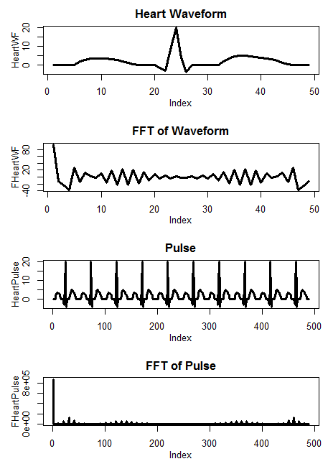
Pulse
I constructed this pulse train from some ECG graphs

Slide 18
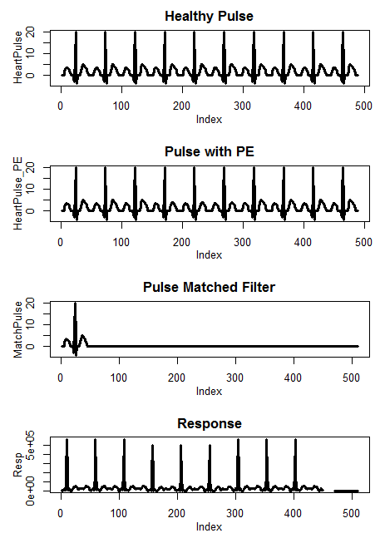
Pulse with Pulmonary Embolism
This is a healthy pulse
This pulse has signs of a pulmonary embolism (weak T wave)
I used a healthy waveform for my matched filter
Note the lower correlation on the 4-5-6 beats

